Slide 1
Fermi Paradox
-and a variety of tangential topics

Slide 2
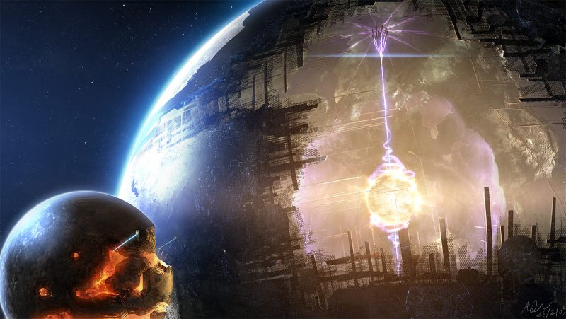
Fermi Paradox
is the apparent contradiction between the lack of evidence for extraterrestrial civilizations and various high estimates for their occurrence
Where are the smart aliens?

Slide 3
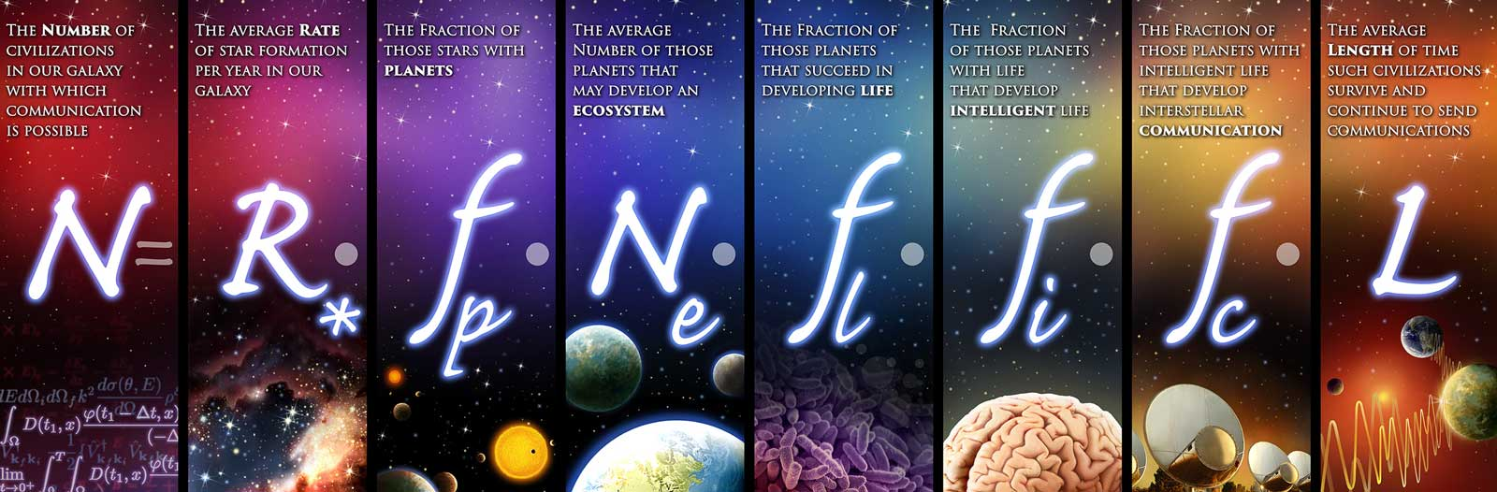

Why High Probability of Alien Life
100–400 billion planets in our Milky Way
2 trillion galaxies in the observable universe

Slide 4

3 Possibilities
We are the first
We are rare
We are fucked

Slide 5
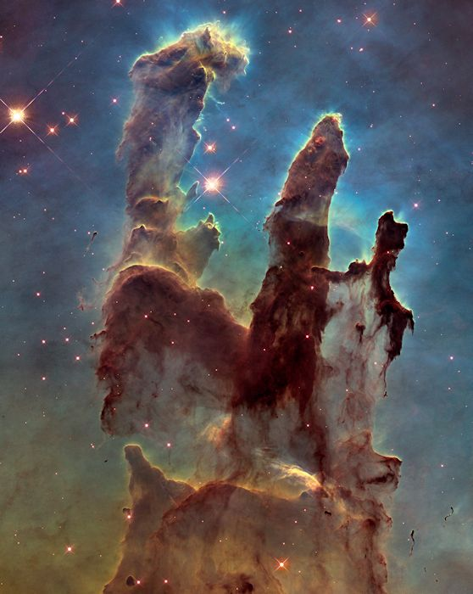
We are first
The universe has only existed for 13 billion years
First life was 3.5 billion years ago
First few billion years was spent making carbon
Many more stars are on they way

Slide 6

We are Rare
The barrier is behind us and we passed it
The jump to life
Habitable planets are rarer than we think
The jump to multicellular organisms
Mitochondria is alien in origin, cooperation may have been very unlikely
making the jump to intelligence/civilization
Homo erectus existed for over a million years
We only came around 200,00 years ago
We only really started meaningful technology in the past few thousand years
Is maxing iq points really a viable build?
Catastrophic events keeps wiping out life before they can get anywhere, like gamma ray bursts

Slide 7
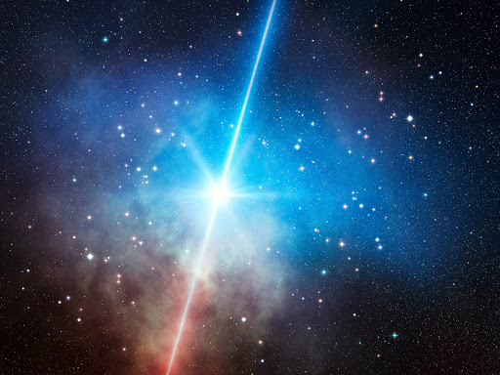
What Are Gamma Rays Bursts?
They are bursts of gamma rays!
Except in a few seconds they release more energy than the total output of our sun in 10 billion years
Causese: Colliding neutron stars, colliding black holes, neutron and black hole collisions
Fun fact: The black hole collision that resulted in the confirmation of gravitational ways released more energy than all the stars in the entire universe
There's about 1,000,000,000,000,000,000,000 stars in the universe outputting around 1000000000000000000000000000000000000000000000000 W of energy

Slide 8
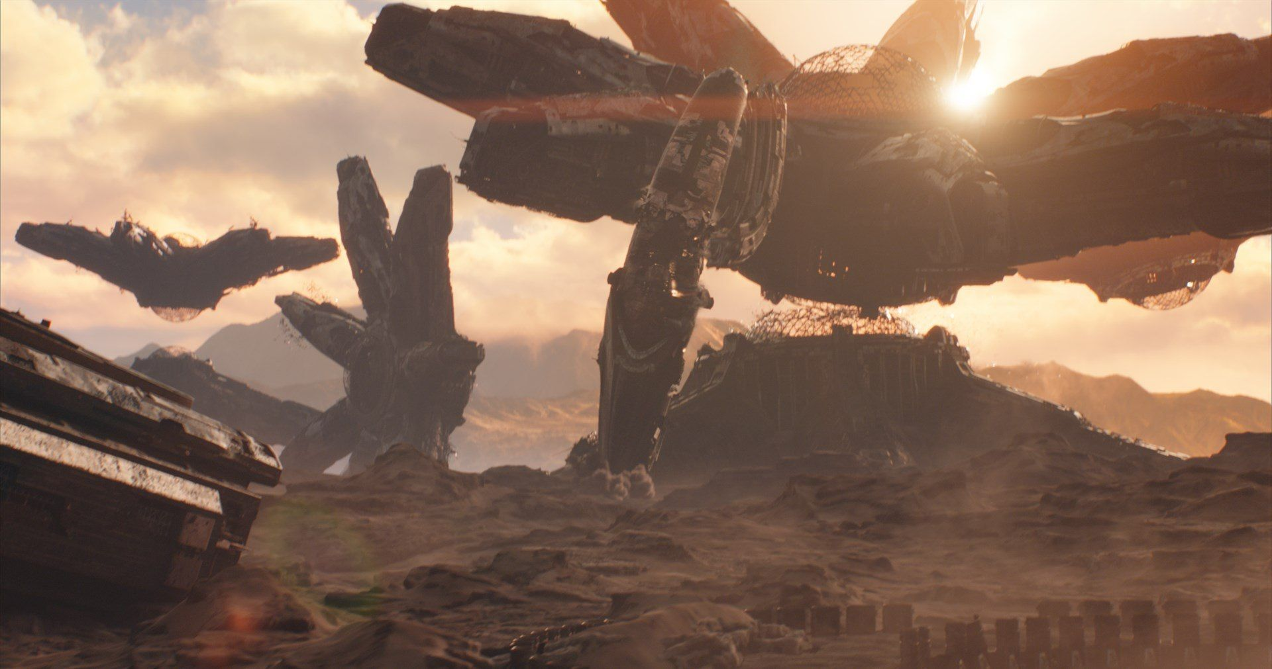
We are screwed
Barrier is in front of us
Society collapses and war takes us back to the stone age
AI kills us all
Genetic engineering results in a lack of genetic diversity and we all die from one disease
Superbugs wipes us out
Pollution wipes us out
Other

Slide 9
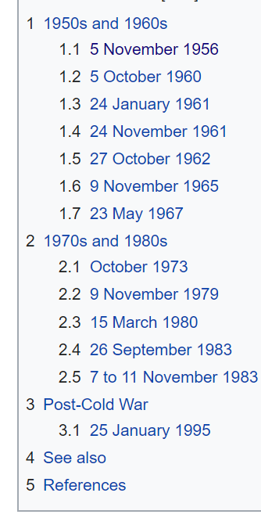
How Close Were We
The US has alone has lost 8 nuclear bombs
October 27, 1962: Soviet Sub Commander ordered nuclear missiles to be fired, 2 out of the 3 switches were flipped. Most subs only require 2 flips.
September 26, 1983 - A Soviet colonel refused to make the phone call that will trigger a retaliatory strike against the US

Slide 10
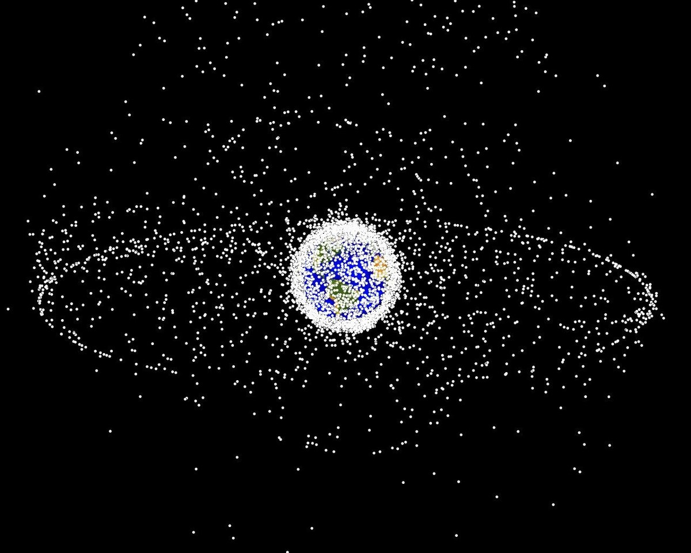
Pollution: A prison
More than 500000 pieces of debris, or “space junk
Can cause cascading effect

Slide 11
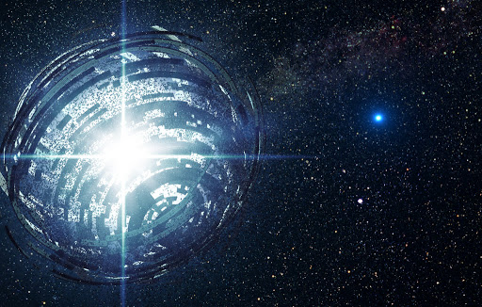
Other Explanations
They are too different
Everybody is hiding in fear
Interstellar travel is too hard
No need to explore

Slide 12
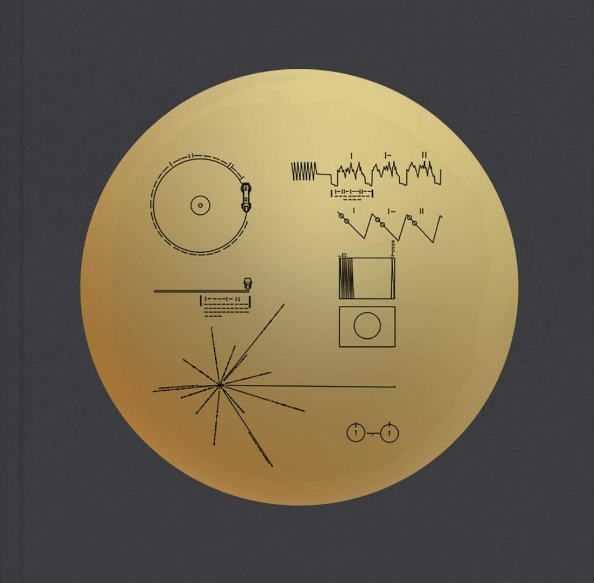
Speaking of too different
Launched in 1977
It is a whooping 22.2 billion km’s away - the furthest man made object. Or just 0.002346 light years away.
Only took 43 years traveling at a slow pace of 35,000 mph,
Still in communication!
Notes:
Hydrogen transition release electro magnetic radition with 0.7 nanosecond period and 21cm wavelength
Period of pulsars are described

Slide 13
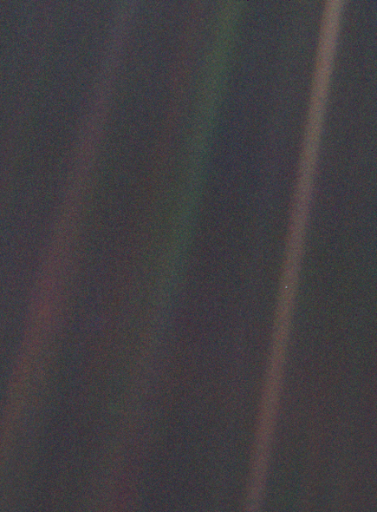
A Pale Blue Dot
“Look again at that dot. That's here. That's home. That's us. On it everyone you love, everyone you know, everyone you ever heard of, every human being who ever was, lived out their lives. The aggregate of our joy and suffering, thousands of confident religions, ideologies, and economic doctrines, every hunter and forager, every hero and coward, every creator and destroyer of civilization, every king and peasant, every young couple in love, every mother and father, hopeful child, inventor and explorer, every teacher of morals, every corrupt politician, every "superstar," every "supreme leader," every saint and sinner in the history of our species lived there-on a mote of dust suspended in a sunbeam.

